Slide 1
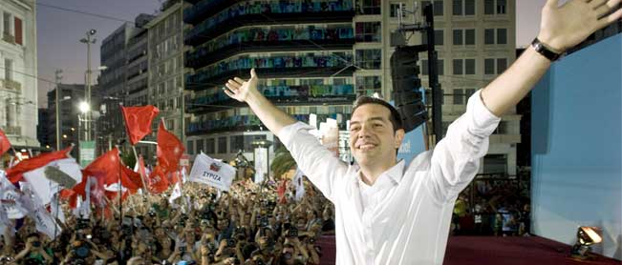
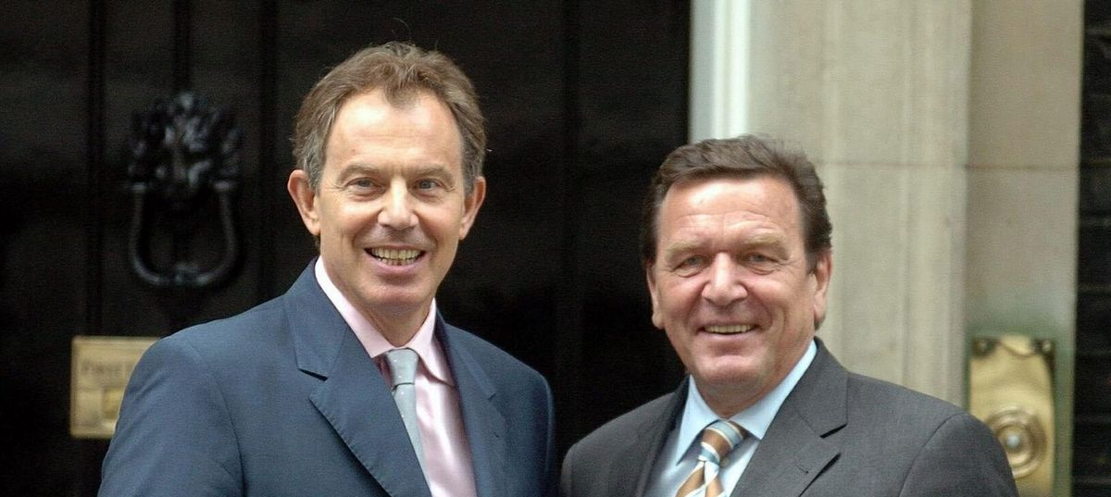
Two directions for The Left?
Luka De Lacey

Slide 2
Original Paper – Werner Krause
Original Paper – Werner Krause (2020)
RQ: How and to what extent do Radical Left parties’ (RLPs) programmatic offerings influence their electoral performance?
Key focus: how RLPs positioning themselves on issues relative to other parties benefits them.
RLPs compete as ‘niche’ competitors – on the fringes of mainstream centre-left and centre-right politics. Positions are relative.
RLPs vary in the degree they have adjusted their programmatic offerings in the post-soviet era.

Slide 3
Original Paper – Key ideas
Challenger parties can benefit by presenting themselves as a credible/viable alternative to mainstream party electorate via centripetal movement.
Challenger parties can benefit through issue entrepreneurship – addressing issues neglected by mainstream/alternatives.
Extreme positions on less established dimension may allow parties to establish themselves as ‘owners’ of the issue. RLPs.
Voters more open to movement on economic dimension (pragmatic) than social (principled).
Maintaining extreme positions risks in the long-term on established issues risks party becoming political pariah.

Slide 4
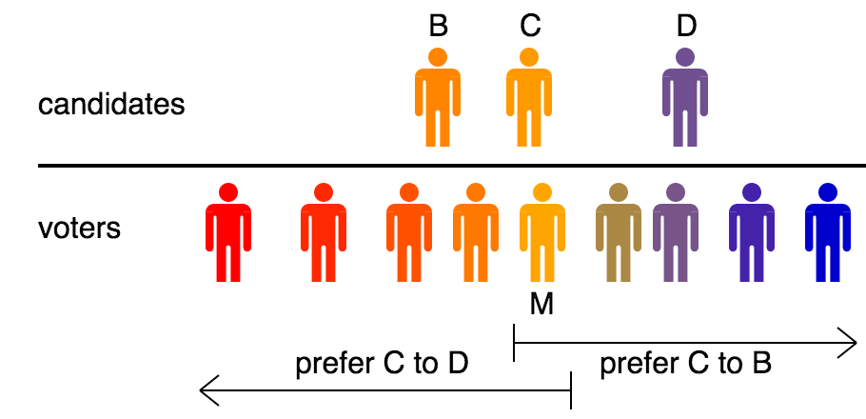
Downsian model: Median voter theorm
Downs (1957).
Uni-dimensional axis on economic positions.
Voters choose the candidate they are closest to.

Slide 5
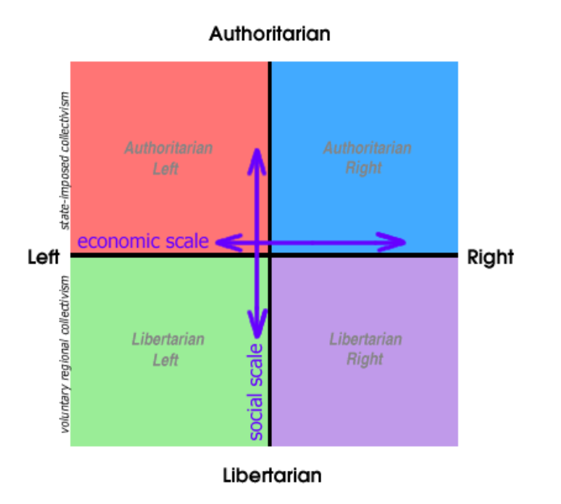
Multidimensional approach
Multi-dimensional axis.
Recognises the increasing prominence of second-dimension issues.
Similar logic applies with the median voter theorm.

Slide 6
Original Paper – RLP relevance
RLPs already established on economic dimension – party-issue linkage with state-market control -> allowing them to moderate.
RLPs are tangentially established on GAL-TAN -> allows distinction on new dimension, attracting new voters, but centrifugal movement is expected. RLPs also vary in willingness to adopt.
RLPs don’t compete in a vacuum and have to content with SD adaptation to new issues and challenger parties themselves.
Mainstream parties are agenda setters – RLPs need them to exist in the same issue space.

Slide 7
Original Paper – Hypotheses
Original Paper – hypotheses
Hypothesis 1: Radical left parties’ vote shares increase the more they moderate their position on the economic conflict dimension.
Hypothesis 2: Radical left parties’ vote shares decrease the more they moderate their position on the non-economic conflict dimension.
Hypothesis 3: The effect of RLPs’ centripetal shifts on the economic conflict dimension will increase the more mainstream left parties are positioned toward the leftist end of this scale.
Hypothesis 4: The effect of RLPs’ centrifugal shifts on the non-economic conflict dimension will increase the more mainstream left parties are positioned toward the libertarian end of the scale.

Slide 8
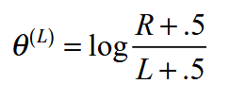
Manifesto position coding
Key methodological approach of the paper:
Log transformed positioning variables –> log ratio of position.
Key left and right issues on each dimension added, then input into formula.
Why:
Manifesto length can dilute true position.
Accounting for marginal shifts in positions - shift from 1 -> 6 relateively greater than 40 -> 45.
(Lowe et al., 2011)

Slide 9
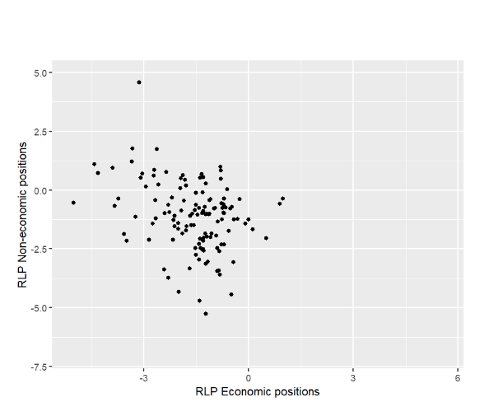
Mapping RLP positions
First replication step – RLPs plotted on two dimensional axis based on coded positions.
120 observations: cut from 210 in base dataset provided. This is largely due to lack of coding in manifesto project.
Visualisation shows:
RLPs skew to the left – expected.
More variance on non-economic.
Notes:
Clear skew on economics, GAL-TAN seems to vary more.

Slide 10
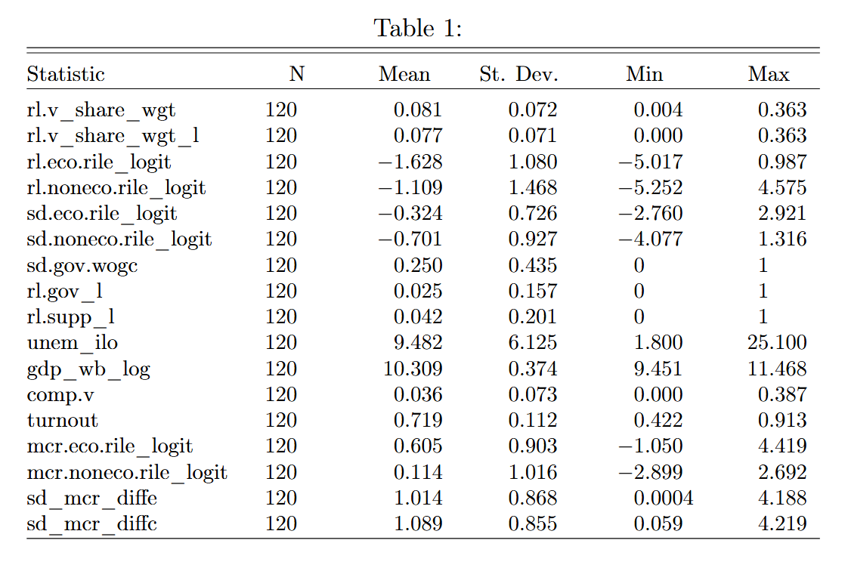
Summary statistics
DV: RLP vote share.
IVs: RLP econ & non-econ rile, SD econ & non-econ rile.
Controls:
Previous election result.
Turnout.
Logged GDP & Unemployment.
Additional RLP competitor.
Left-wing Government, In/supporting a government.
Interaction variable (RLP-SD rile).
Notes:
Clear skew on economics, GAL-TAN seems to vary more.

Slide 11
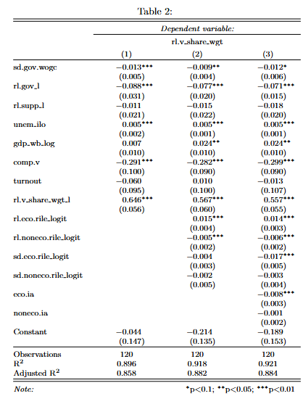
Replication of regression
Three models:
Controls
Key IVs: RLP & SD positions.
Interaction effects
All models are OLS with standard errors clustered by election date and party (correlation with units over time) with party fixed effects (limit party/country heterogeneity).

Slide 12
Replication of regression
Model 1
Statistically significant effects among most controls – not turnout, GDP or governmental support.
Model 2
GDP becomes significant
Both RLP positions are significant.
Reject null hypotheses of H1 and H2.
Model 3
Interaction effect – statistically significant on econ.
RLP moderation is conditional on SD position, if SD is more right-wing, it is associated with a decrease in RLP vote share.
Coefficient becomes +0.006 – a 0.6% increase.
Cannot reject H4 – can reject H3.

Slide 13
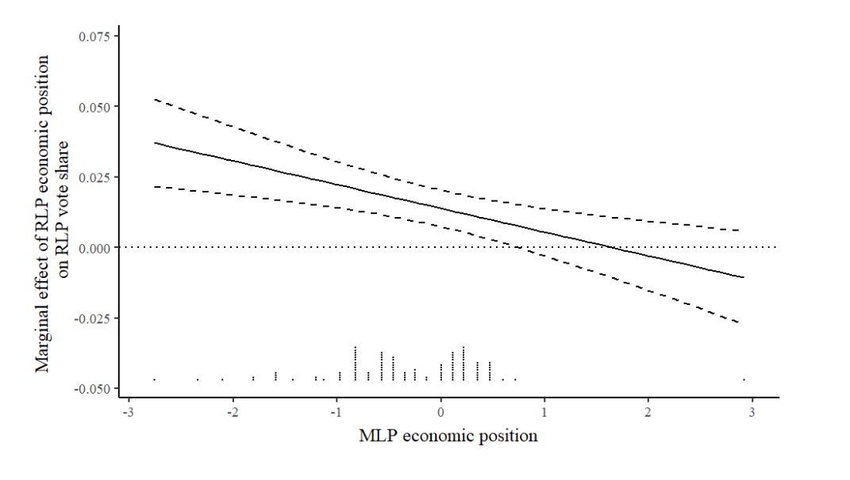
Marginal effect of economic moderation
Marginal effects plot illustrates the effect of the interaction.
It shows the more left the SD, the greater the effect of RLP moderation.
The associated increase in vote share of a unit increase in the log position of RLP on vote share is on average conditioned by SD position.

Slide 14
Original Paper – Hypotheses
Extension - Theory
Core point of Krause (2020): RLP competition with SDs and (occasionally) alternative Lib-Left parties influences result.
My addition: SD distance from MCR
Lit on SDs suggests that Third-way moderation and austerity participation hurt SDs.
In-part this involved blurring the lines between them and Main Centre-right party.
Theoretically this should benefit alternative economic issue owners – RLPs.
Argument: The smaller the difference between SD and MCR on economics, the more likely RLPs increase their vote share.
Interaction effect: RLPs positions may be related to SD-MCR distance.

Slide 15

Examples
Election | Party | Percent change | Party family
Greece May 2012 | SYRIZA | +12% | RLP
 | PASOK | -30.7% | SD
Ireland 2016 | AAA-PBP | +1.7% | RLP
 | Sinn Féin | +3.9% | RLP*
 | Labour | -12.8% | SD
Netherlands 2017 | SP | -0.5% | RLP
 | GL | +6.8% | Green
 | PvdA | -19.14% | SD
Spain 2015 | Podemos | +20.7% | RLP
 | PSOE | -6.8% | SD

Slide 16
What I did
Used previously coded data for masters thesis which codes for key centre-right party per election and MAPOR data.
Steps:
Code MAPOR data in-line with Lowe, et al. (2011) – as done by paper.
Calculate difference in position between parties – aggregating results and log transform.
Additional interaction variables between RLP positions and this difference.
Ran four models – removing SD position in two case of collinearity, adding interaction effects in one of each case.

Slide 17
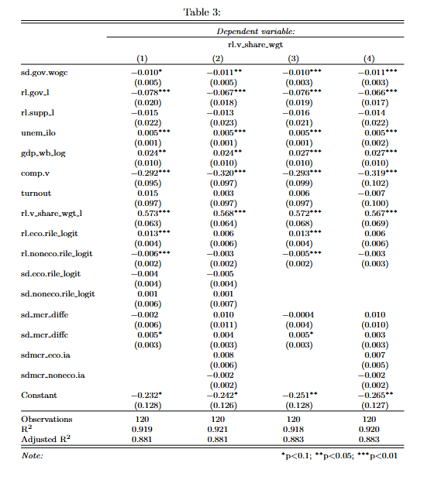
Extension
regression
4 models
Both distance variables.
Distance and interaction.
Removal of SD positional vars, with distance.
Removal of SD positional vars, with distance and interaction.

Slide 18
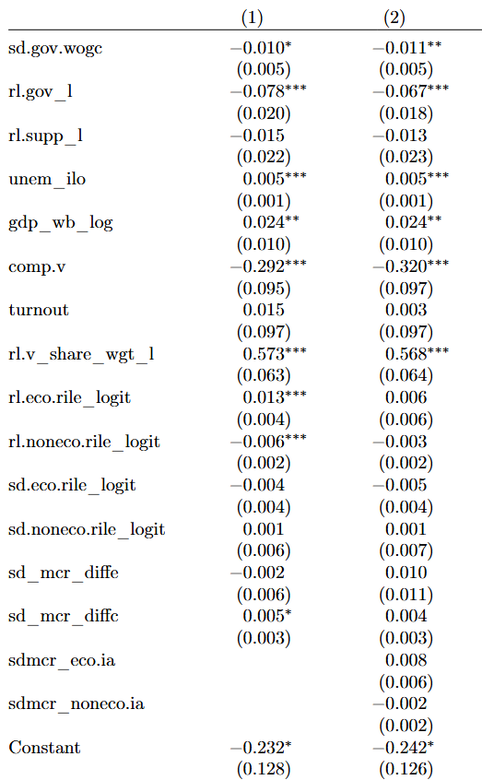
Extension Regression: Models 1 & 2
Both include SD positioning.
Model 1
Results largely resemble Krause (2020).
SD-MCR non-econ distance marginally significant, positive.
Model 2
Including interaction effect completely removes RLP position significance.

Slide 19
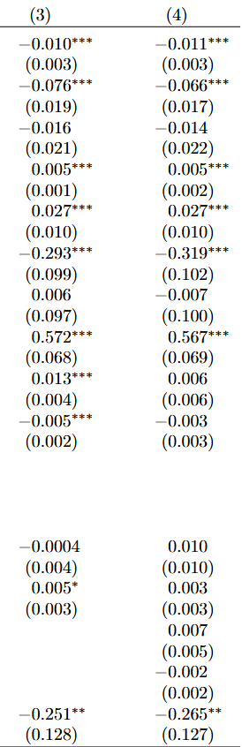
Extension Regression: Models 3 & 4
Both remove SD positioning.
Model 3
Results largely resemble Krause (2020).
SD-MCR non-econ distance marginally significant, positive.
Model 4
Including interaction effect completely removes RLP position significance.
Suggests that effect of RLP positioning may be conditional on MCR-SD distance.
But testing for correlation – may be some collinearity – Pearson correlation coefficient is 0.59.

Slide 20
Findings
Non-significant effect of SD-MCR distance on economic or culture.
Including interaction variable – unlike Krause (2020) interaction – significance of RLP positions are lost.
Though may Pearson correlation test returns value of 0.59
These findings mean the null hypothesis cannot be rejected:
that on average, when holding the additional variables constant – the distance in MCR and SD positions on economic and non-economic issues does not
A potential addition to further test: limited observations – expand on them

